Slide 1
Flight
Booking System
Project by Shivam Prakashrao Hatwar

Slide 2

Objective
Flight booking System is an application to meet the needs of online Flight reservation system, with 1 actor: i.e. User
The objective of system is provide a solution for users to book flight tickets, search for tickets, view booking details.

Slide 3

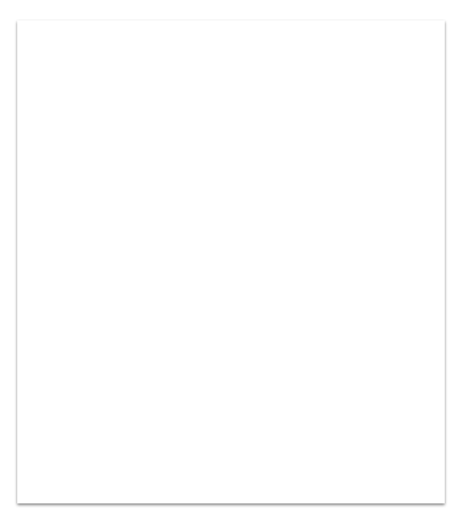
Presentation Layer:
NodeJS 12.16.0 (Javascript Runtime Environment)
Angular 6 (framework to develop web apps)
VSCode 1.44.2(to develop front end)
Business Layer Java 8 (base programming language)
Postman 7.23.0 (for running RESTful
service).
Spring framework (for creating webservices)
Spring Boot 2.3.0 (auto configuring)
Technology Stack
Persistence Layer:
Hibernate 2.1 (JPA implementation)
Spring Data 2.1.9 (performing repository ops)
Oracle 11g(database storage)
Cross Cutting Concern:
Spring Security
.DevOps:
Maven 4.0.0 (Build & manage project)
Hardware and Software Requirements:
Windows 7, RAM 4GB, I.E 7+ or Google Chrome, Memory Space: 500MB.

Slide 4
Functionality
Register If User do not have an account, they have to register by providing their name and usernames, their contact number, age and email ID.
Search Flight
On providing the source and destination city, a user will be able to view all the relevant flights.
Book Ticket:
A user will be able to book a new ticket by choosing a flight
View Ticket
User will be able to view all booked tickets at a glance
Cancel Ticket
User will be able to cancel the unnecessary ticket.

Slide 5

Scope of Project.
Design and implementation of online bus reservation system
A customer can view different buses after entering the boarding and arrival locations
All the mentioned functionalities will be integrated together with the help of a Controller.
There will be a page dedicated to Executive member of the Company.

Slide 6
Outside the scope
Providing the facility to link bank account and other wallets to initiate and refund transaction in booking and cancellation of tickets.
Sending message or OTP regarding the details of the booking done to the customer's phone number.

Slide 7


Future Work:
Social Media Integration
Cloud Services with AWS

Slide 8
Thank you!

